Slide 1

Project : Java and Web Development
GitHub Repository :
https://github.com/mxtimu-iu/StudyJar_DLBCSPJWD01.git

Slide 2

Phase 2: Development Phase
Name: Matimu Ngobeni
Student Number: 9219464
Date: 16 June 2025
Subject Code: DLBCSPJWD01

Slide 3





What is the purpose of Study-Jar ?
Visualize your progress:
The web app provides detailed statistics and charts that help you track how much time you've spent focusing daily, weekly, or monthly, allowing you to reflect and improve.
Customize Focus Sessions:
Study-Jar allows you to set custom focus times, tag your sessions which makes your experience more personalized and enjoyable.
Gamify the Focus Experience:
Study-jar turns focus into a game by letting you fill a virtual with water as you concentrate, giving a clear visual of your daily progress
Improve Focus and Productivity:
The web app helps users stay focused by encouraging them to stay off their phones.

Slide 4
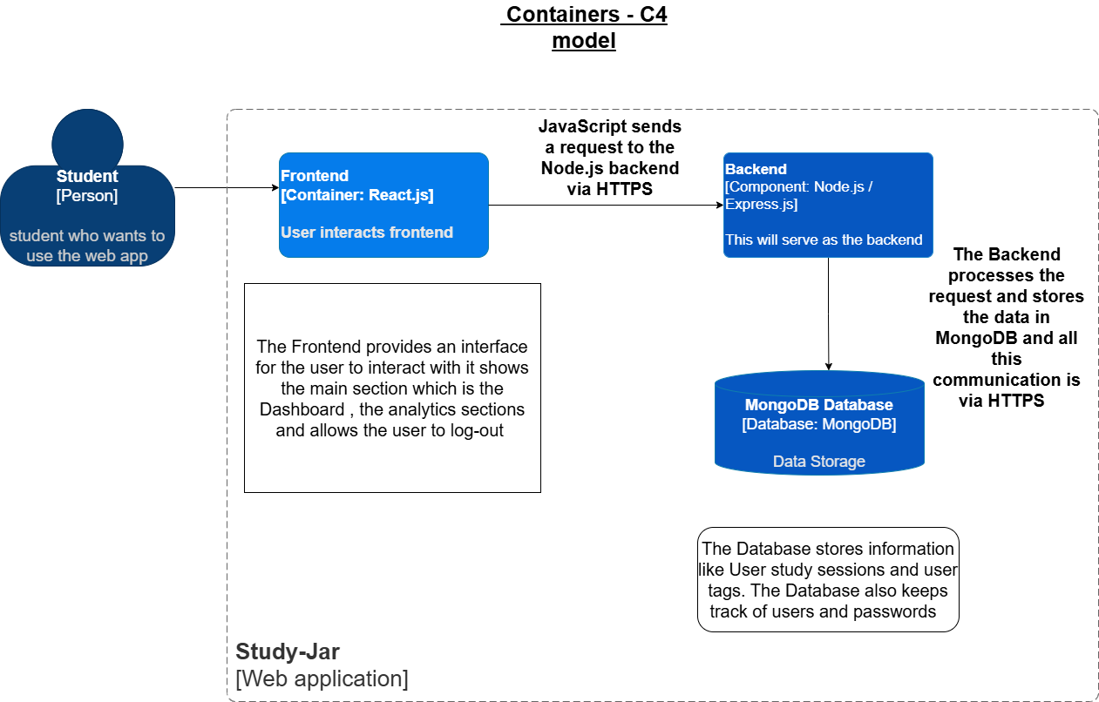
Architecture : Container Diagram Of C4 Model
Study Jar is a free, student-friendly productivity web app that helps users track study time by logging sessions, tagging modules, and setting daily goals. It visualizes progress with graphs and stats, offering a personalized alternative to premium apps like Forest.
Figure 1: The Architecture Container. Created using Draw.io

Slide 5


Tech Stack for Study-Jar
Frontend
Backend
The project is built with JavaScript, using React.js and Tailwind CSS for the frontend. The backend is powered by Node.js with Express.js, and MongoDB for data storage. Recharts is used to display study analytics through interactive charts and bar graphs.
Node.js with
Express.js Framework
MongoDB as a Data Storage
React.js and
Tailwind for styling

Slide 6
Changes to my proposal
Feature | Original Proposal | Final Project
Allow dark mode for late night study sessions | Not proposed due to focus on core features | The dark mode allows users to use the web application in light or dim areas where dark mode would be helpful
Landing page to make the web application feel more dynamic | Not proposed due to focus on core features | Beautiful landing page that explains why users should choose Study-Jar

Slide 7
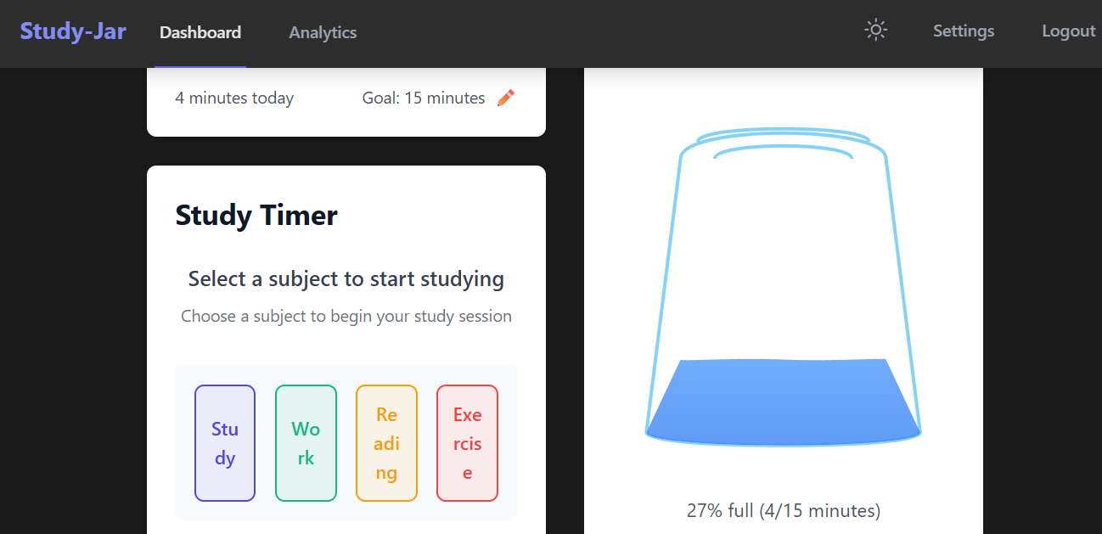
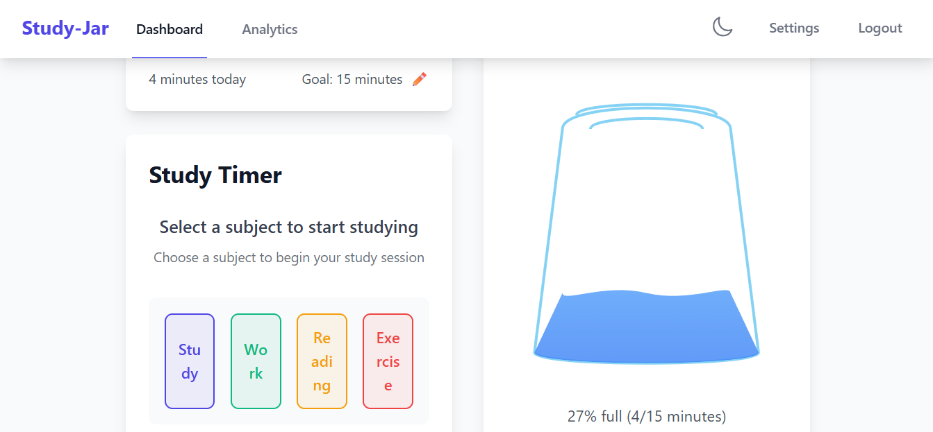
Function: Allows users to switch the web application back to Light Mode. Light Mode is ideal for bright or well-lit environments, where dark themes may be harder to see.
Function: Allows users to switch the web application to Dark Mode.
Dark Mode provides a more comfortable viewing experience in low-light environments, reduces eye strain.

Slide 8
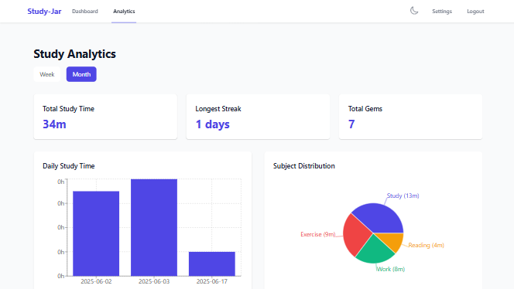
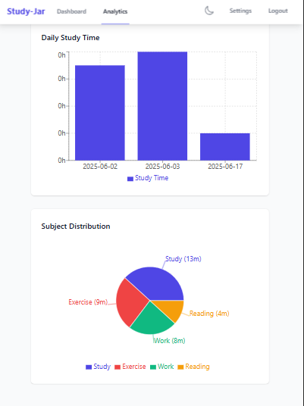
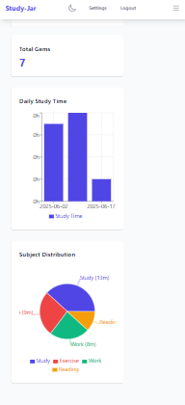
Responsive Design for the Study-Jar web Application
Desktop: Isus Intel Celeron
Tablet: iPad Pro
Phone: iPhone 12 Pro Max

Slide 9
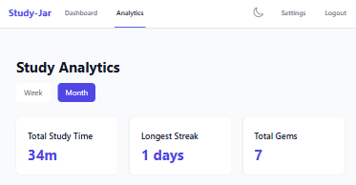
This screenshot highlights the Study Analytics section of Study-Jar.
which provides users with a detailed overview of their study performance.
At the top, users can view their total study time broken down by month and week, offering insights into both long-term and short-term study habits.
It also displays the user’s longest study streak, which tracks the highest number of consecutive days studied — encouraging consistency and discipline.
Lastly, the section shows the total number of gems earned. These gems represent the total number of study sessions completed, serving as a motivational reward system to help users stay engaged and track their achievements over time.

Slide 10
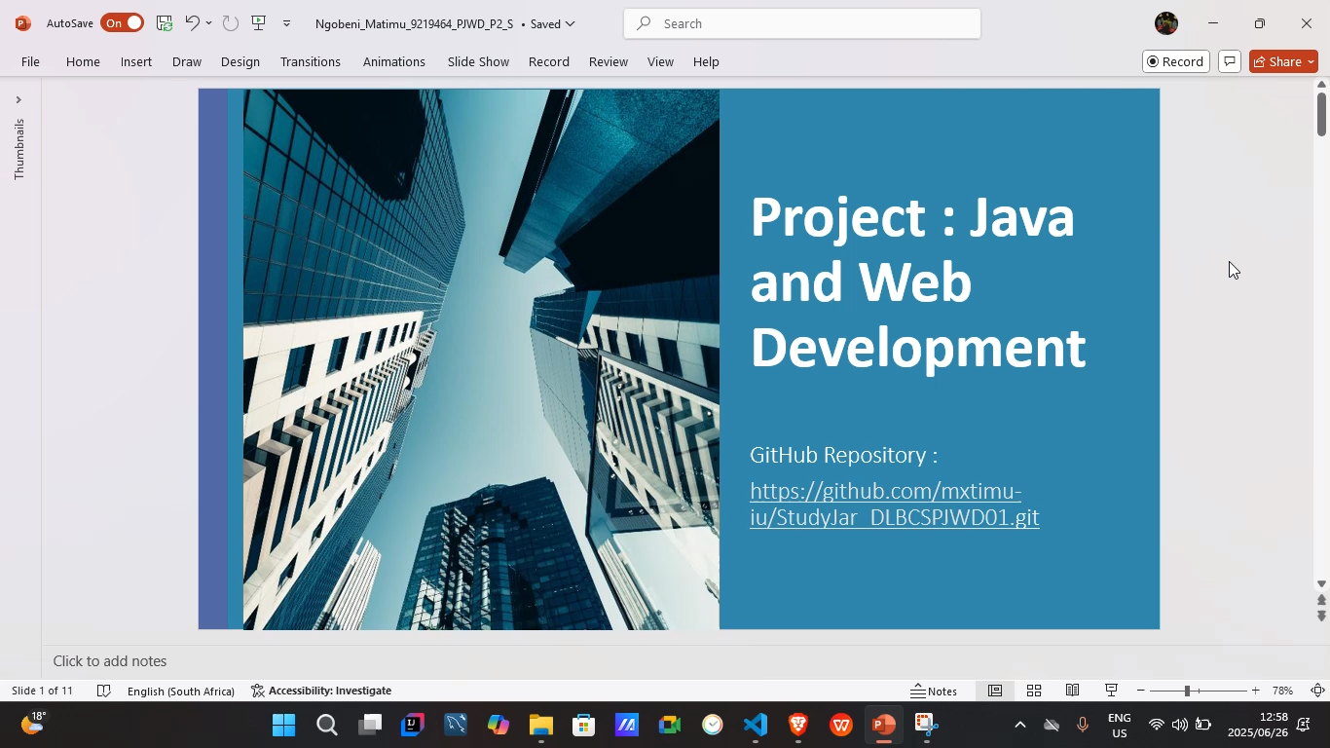

Slide 11
Bibliography
Author’s own work. (2025). Screenshots from Study-Jar web Application.
https://github.com/mxtimu-iu/StudyJar_DLBCSPJWD01.git
Draw.io , Online Graphic design tool. https://www.drawio.com
PowerPoint presentation and editing tool
Link to video JUST in case the video is not embedded : https://drive.google.com/file/d/1CsI_4mIP7cp5-yxXzR3JdpZmFmi4KDYT/view?usp=sharing
List of Figures
Figure 1: Architecture Diagram of the Study-Jar diagram, created by the Author using Draw.io
Figure 2: Screenshots from the Study-Jar web application
https://github.com/mxtimu-iu/StudyJar_DLBCSPJWD01.git

